Slide 1
Week 7 Demo
Jeffery Jiang

Slide 2
Concurrency vs Parallelism
Concurrent programming handles several operations at one time and doesn’t require hardware support (using either one or multiple cores).
Parallel programming executes multiple operations at the same time on multiple CPUs. Parallelism is achievable only on multi-core devices.

Slide 3
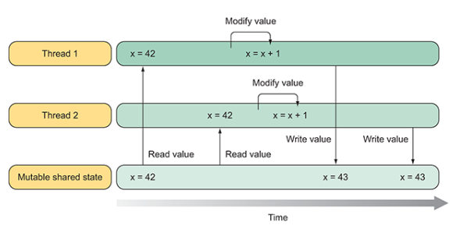
Race Condition
Solution:
Use lock

Slide 4
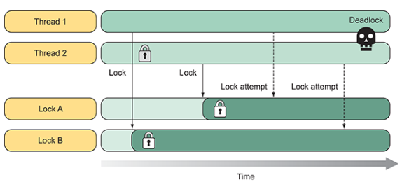
Dead Lock

Slide 5
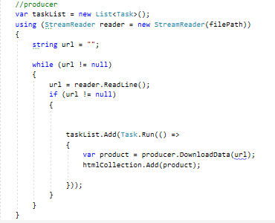
Issues

Slide 6
Data Annotations
Add validation rules to models in MVC
Having validation rules automatically enforced by ASP.NET Core helps make your app more robust. It also ensures that you can't forget to validate something and inadvertently let bad data into the database.

Slide 7
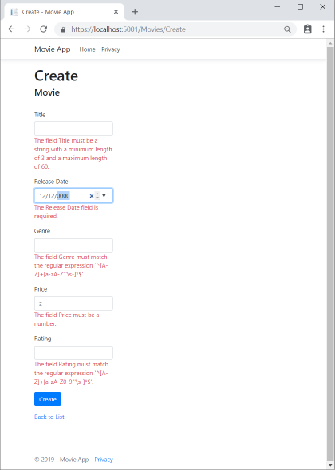
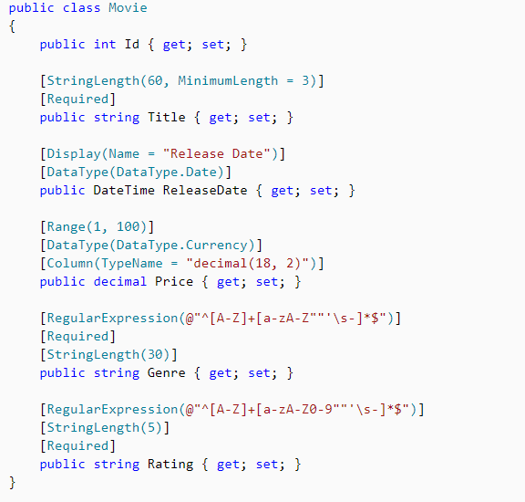
Data Annotations

